Slide 1

High-School Maths
Establish a workflow, get to know our tools, review basic concepts
Yordan Darakchiev
Technical Trainer
iordan93@gmail.com

Slide 2
sli.do #MathForDevs

Slide 3
Table of Contents
Motivating examples
Methods
Divide and conquer
Scientific method
Setting up our environment
Python 3.7, Anaconda, Jupyter Notebook
Math notation
Scientific notation
Summation
Linear equations and systems of equations

Slide 4
Motivating Examples
Math in real life

Slide 5
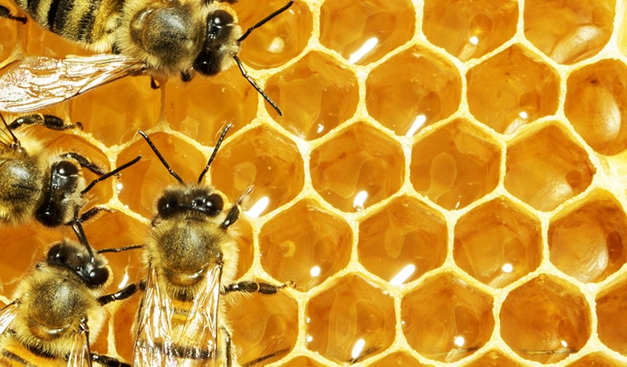

Mathematics in Nature
Honeycomb cells
Bees produce wax by consuming some of the honey they’ve made
Wax production takes time and energy (honey)
The hexagonal cells leave no unused space, and consume the least amount of wax and energy
Snowflakes
All snowflakes are unique but they are perfectly symmetrical
Each arm (unless damaged) is identical
This makes them strong enough to stay together

Slide 6
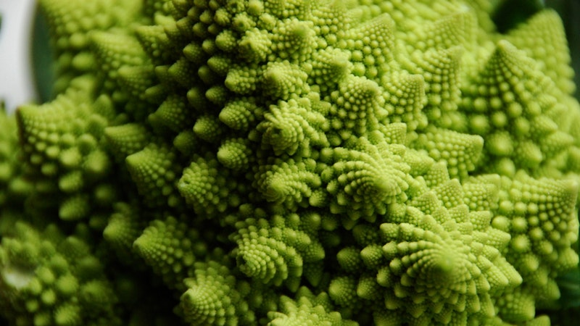
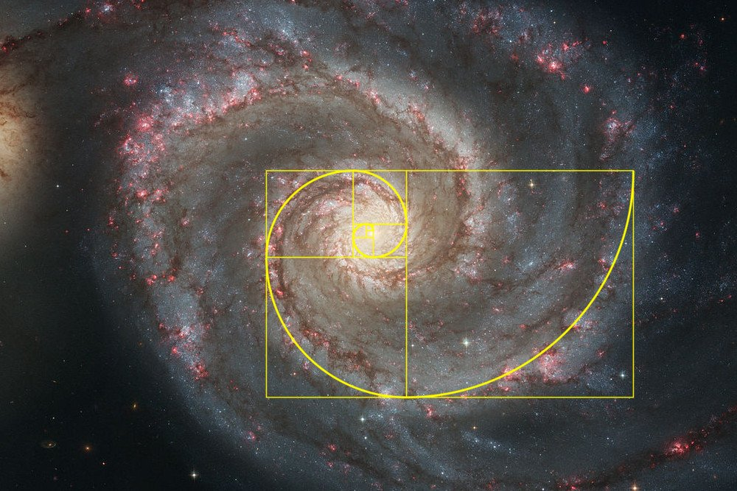
Mathematics in Nature (2)
Romanesco broccoli
Each little floret looks exactly like the whole plant
This is called a fractal
Seen from above, the florets form a spiral
This is a Fibonacci spiral
Fibonacci spirals everywhere
Flowers, pinecones
Animal shells
Hurricanes
Galaxies

Slide 7
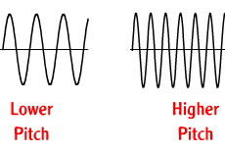
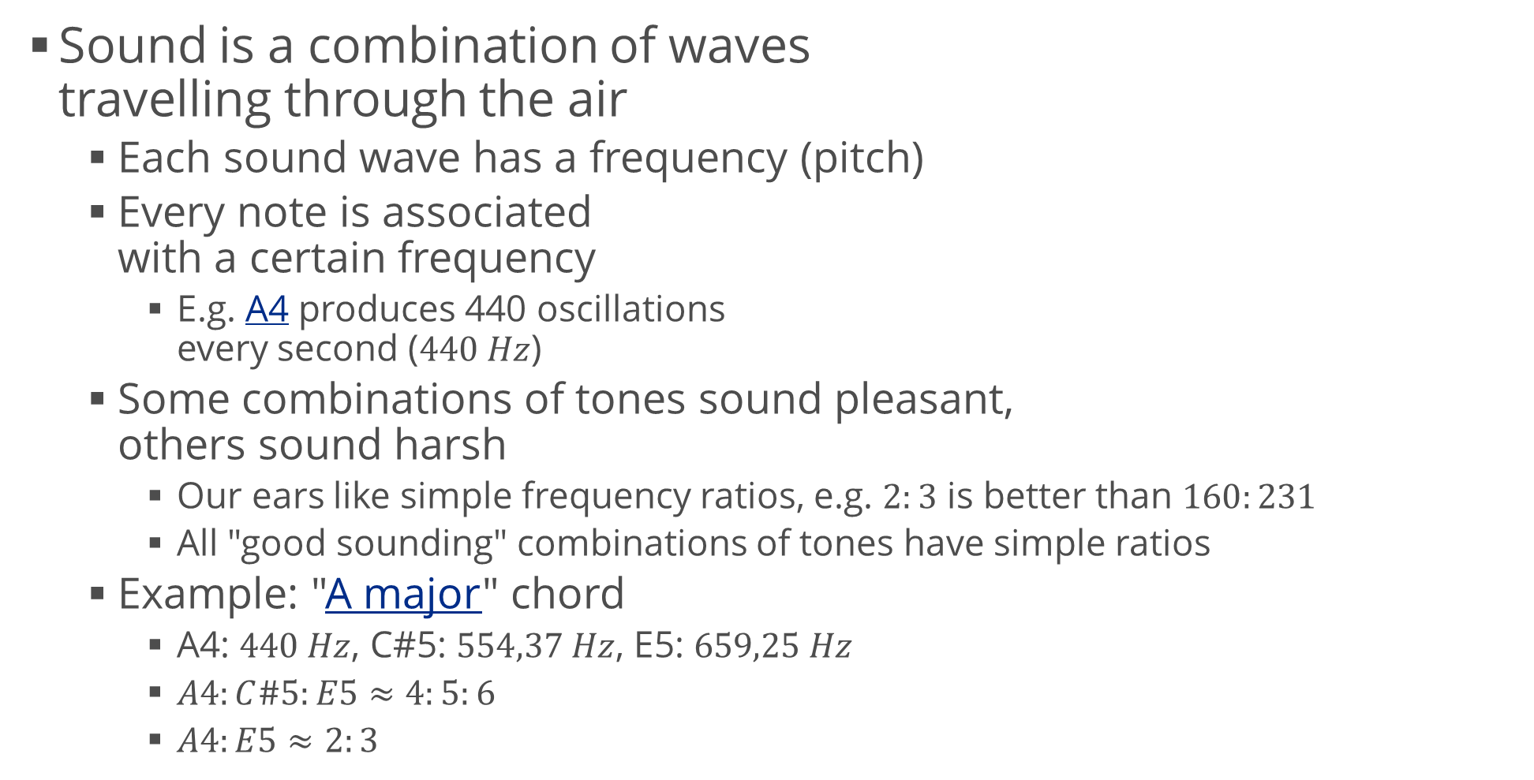
Mathematics in Music
Sound is a combination of waves travelling through the air
Each sound wave has a frequency (pitch)
Every note is associated with a certain frequency
E.g. A4 produces 440 oscillations every second ($440 Hz$)
Some combinations of tones sound pleasant, others sound harsh
Our ears like simple frequency ratios, e.g. $2:3$ is better than $160:231$
All "good sounding" combinations of tones have simple ratios
Example: "A major" chord
A4: $440 Hz$, C#5: $554,37 Hz$, E5: $659,25 Hz$
$A4:C\#5:E5≈4:5:6$
$A4:E5≈2:3$

Slide 8
Methods
How not to get lost

Slide 9
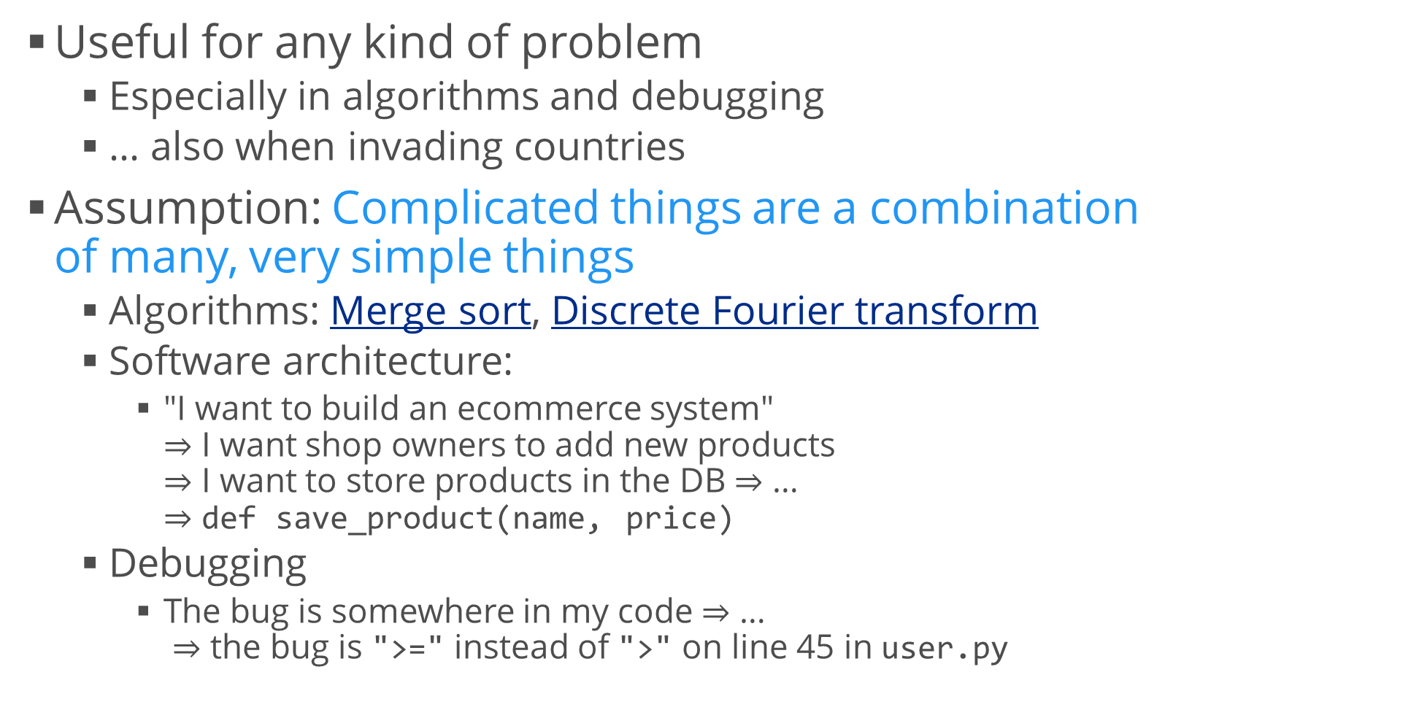
Divide and conquer
Useful for any kind of problem
Especially in algorithms and debugging
… also when invading countries
Assumption: Complicated things are a combination of many, very simple things
Algorithms: Merge sort, Discrete Fourier transform
Software architecture:
"I want to build an ecommerce system" $⇒$ I want shop owners to add new products $⇒$ I want to store products in the DB $⇒$ … $⇒$ def save_product(name, price)
Debugging
The bug is somewhere in my code $⇒$ … $⇒$ the bug is ">=" instead of ">" on line 45 in user.py

Slide 10
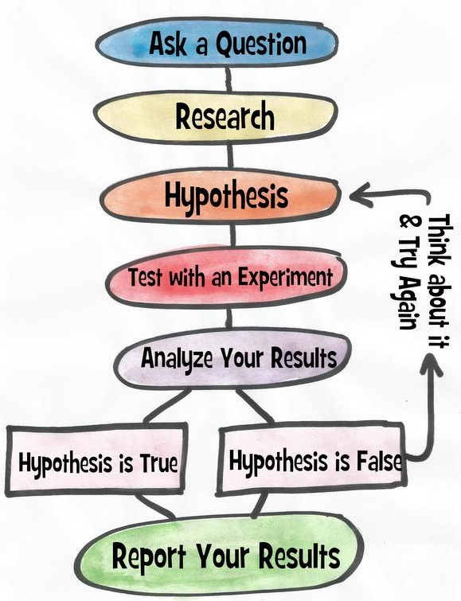

The Scientific Method Steps
Ask a question
Do some research
Form a hypothesis
Test the hypothesis with an experiment
Experiment works $⇒$ Analyze the data
Experiment doesn't work $⇒$ Fix experiment
Results align with hypothesis $⇒$ OK
Results don't align with hypothesis $⇒$ new question, new hypothesis
Communicate the results

Slide 11
Why use the Scientific Method?
Useful when we're exploring something new
A new algorithm
A new codebase we've just been hired to work on
Based on common logic
Experiments
Example: performance testing
Research: My logs show that this Web page on my server takes too much time to load
Hypothesis: This piece of code is too slow. I need to improve it
Control: Measure the runtime (in seconds)
Experiment: Try to fix the problem and repeat the runtime test
Did the fix bring a considerable performance gain?
Communication: Show the results and implement the fix

Slide 12
Setting Up Our Environment
Getting ready to conquer math, science and programming

Slide 13

Anaconda
You can install the Python interpreter and all libraries manually
Hard, boring and repetitive work
Error-prone
Easy solution: platforms like Anaconda
Everything you need to get started with Python for science: Python interpreter, packages (720+), package manager, IDE
Download from https://www.anaconda.com/download/
Current version (February 2020): Anaconda 2019.10
Choose your platform (Windows, Linux, or MacOS)
Download the Python 3.7 version
Follow the installer

Slide 14
Setting Up an IDE (Optional)
You can use the built-in IDE called Spyder
You can even use Notepad if that's your thing
If you want to use another IDE, you have to configure it to work with Python
Syntax highlighting, autocomplete, etc.
If you're using Visual Studio
Python Tools
https://www.visualstudio.com/vs/python/
Visual Studio Code
If you prefer something lightweight, Visual Studio Code is a good alternative
https://code.visualstudio.com/docs/languages/python

Slide 15
Python Online
There are places where you can execute your code online
If you don't have access to Anaconda
Or you want to test something very quickly
https://www.python.org/shell/
Provides a Python shell
https://www.pythonanywhere.com/try-ipython/
Provides an implementation of IPython (Interactive Python)
REPL (Read-Execute-Print Loop)
No major difference to the Python shell
To share your code you can use
http://ideone.com
http://pythonfiddle.com/
http://pastebin.com/

Slide 16

Jupyter Notebook
A very nice and clean way to document your research
Included in Anaconda
Can create documents that contain live code, equations, visualizations and explanatory text
HTML / CSS / JavaScript
Markdown
Python
Start – use the Anaconda shortcut
…or type into the Command Prompt
jupyter notebook

Slide 17



How to Use Jupyter
Create a new notebook
New > Python 3
Every piece of text or code is in a cell
Text cells just contain text or Markdown
Code cells contain code (obviously)
Code can be executed
Jupyter "remembers" the code
Execute cell: Ctrl + Enter
Or use the menus

Slide 18
Math Notation
How to write more quickly and concisely

Slide 19

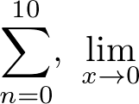
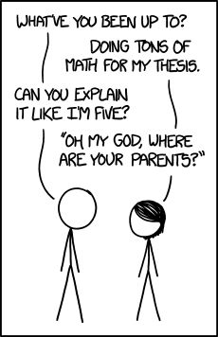
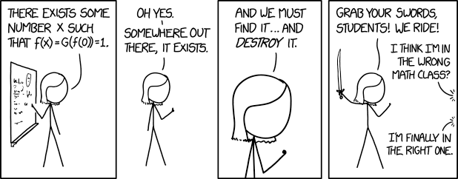
Math Notation
The basic symbols we use are numbers and letters
Usually English or Greek letters
Special symbols:
Indices:

Slide 20
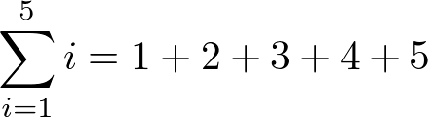
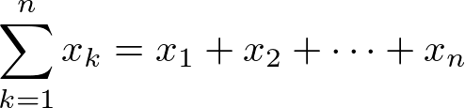
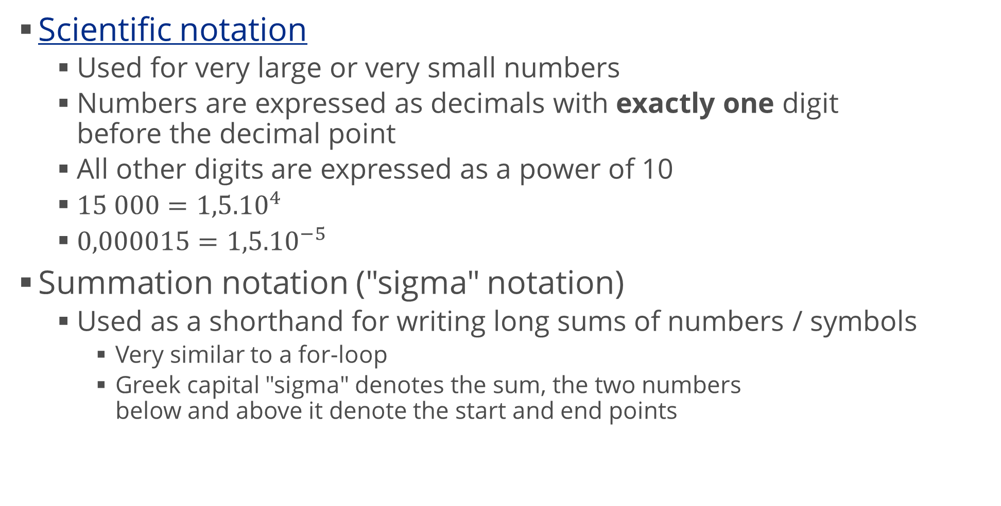
Other Useful Notations
Scientific notation
Used for very large or very small numbers
Numbers are expressed as decimals with exactly one digit before the decimal point
All other digits are expressed as a power of 10
$15 000={1,5.10}^{4}$
$0,000015={1,5.10}^{−5}$
Summation notation ("sigma" notation)
Used as a shorthand for writing long sums of numbers / symbols
Very similar to a for-loop
Greek capital "sigma" denotes the sum, the two numbers below and above it denote the start and end points

Slide 21






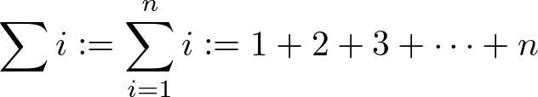
Equality Sign
Important as it has different meanings
Similar to programming: "=", "==" and "==="
Identity
The two statements around "=" are always equal:
We can also use the "identity" symbol:
… for all "valid" symbols:
Equation
The two statements are true only for specific values of the symbols
Definition (we can also use or , or even )

Slide 22
Linear Equations
Simple, yet very useful

Slide 23





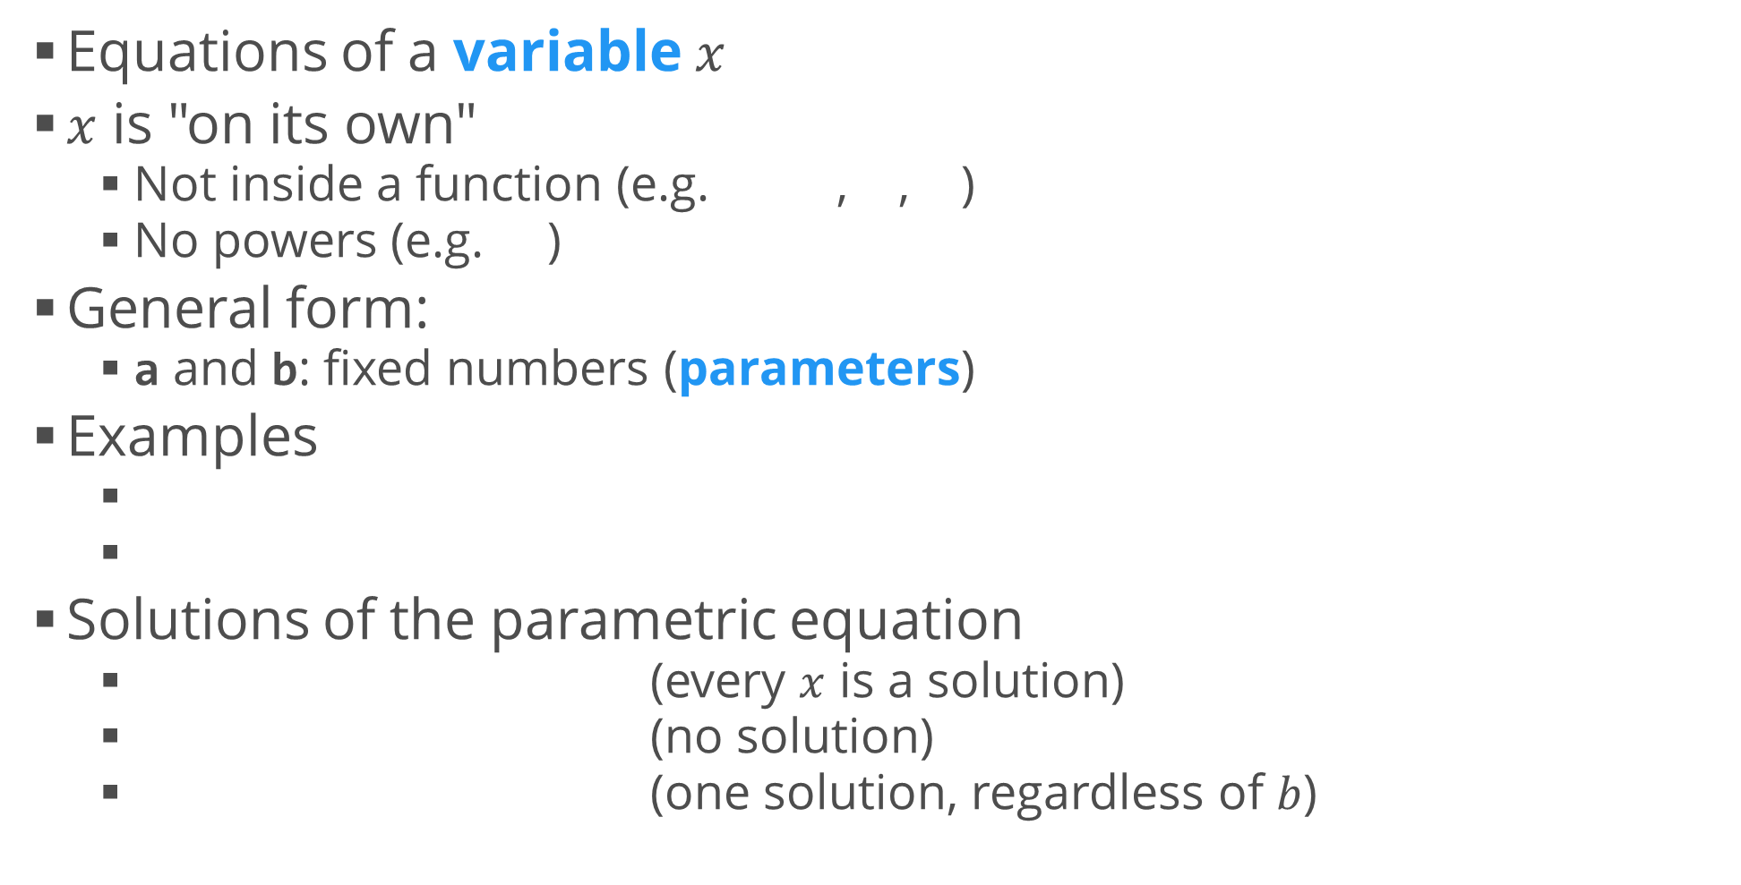
Linear Equations – Review
Equations of a variable $x$
$x$ is "on its own"
Not inside a function (e.g. , , )
No powers (e.g. )
General form:
a and b: fixed numbers (parameters)
Examples
Solutions of the parametric equation
(every $x$ is a solution)
(no solution)
(one solution, regardless of $b$)

Slide 24
Exercise: Linear Equations
Write a Python function which solves a linear equation given the definition from the previous slide
The function should accept the a and b as arguments
The function should return
The solution, if there is only one
nan if there is no solution
Empty list [] if all x satisfy the equation
import math
def solve_linear_equation(a, b):
if a == 0:
if b == 0:
return []
else:
return math.nan
else:
return -b / a
solve_linear_equation(0, 0) # []
solve_linear_equation(0, 5) # nan
solve_linear_equation(5, 0) # 0.0
solve_linear_equation(5, 5) # -1.0
solve_linear_equation(2.5, -5.3) # 2.12

Slide 25
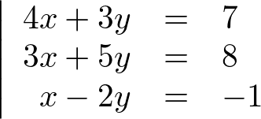
Linear Systems of Equations – Review
Many simultaneous equations
To solve the system, we need to find values of the variable(s) which satisfy all equations at once
Even if all individual equations have solutions, the system may have no solution
Solution
Method 1: Solve one equation and substitute
Method 2: Use sum of equations
Later, we'll learn a faster way of solving these systems
Example

Slide 26






Solving a Linear System
Note: The numbers of equations and variables matter
E.g. this system is "overdetermined"
We'll learn more about this later

Slide 27
Summary
Motivating examples
Methods
Divide and conquer
Scientific method
Setting up our environment
Python 3.7, Anaconda, Jupyter notebook
Math notation
Scientific notation
Summation
Linear equations and systems of equations

